Slide 1

Setting up your goal
Train/dev/test
distributions
deeplearning.ai

Slide 2


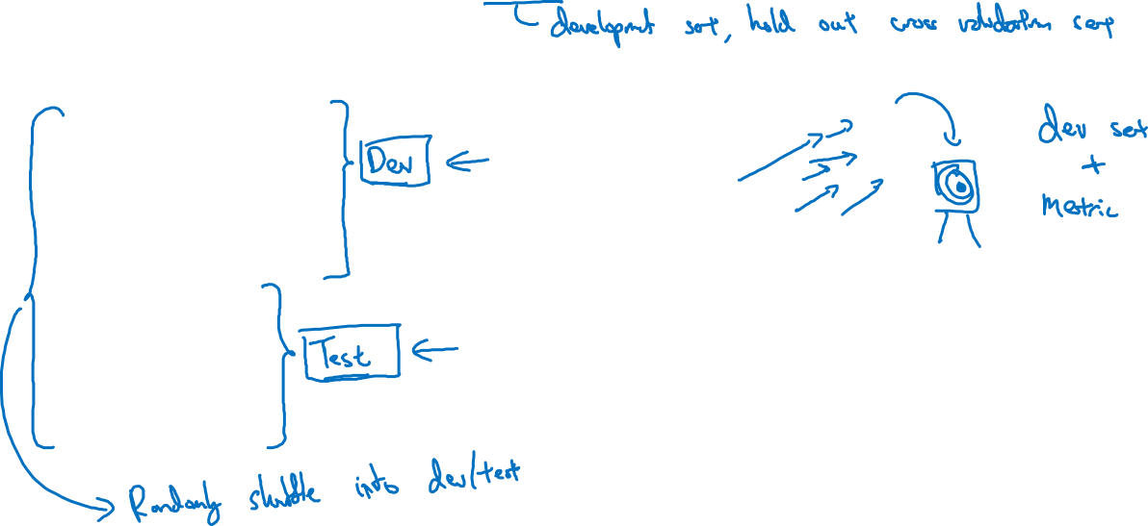
Cat classification dev/test sets
Regions:
US
UK
Other Europe
South America
India
China
Other Asia
Australia
Not good, because Dev set and Test set should come from the same distribution
Idea
Experiment
Code

Slide 3
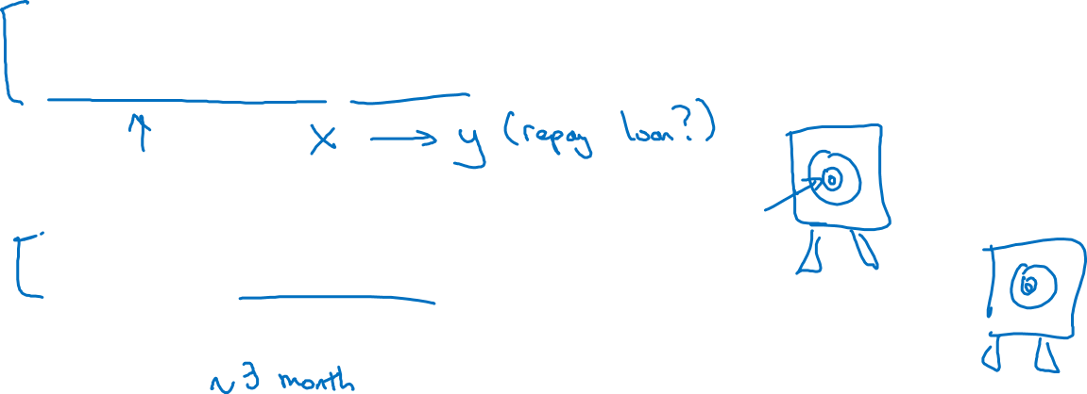
True story (details changed)
Optimizing on dev set on loan approvals for medium income zip codes
Tested on low income zip codes

Slide 4
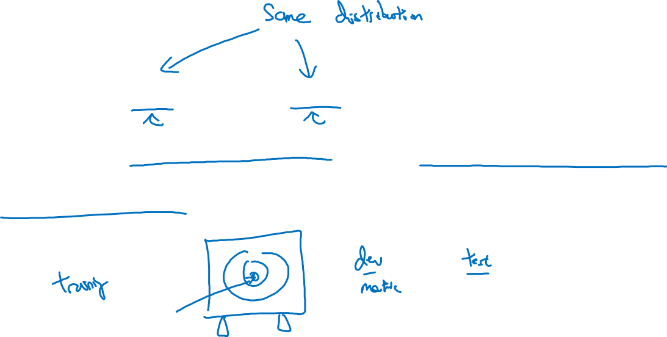
Guideline
Choose a dev set and test set to reflect data you
expect to get in the future and consider important
to do well on.

Slide 5
Main Points
Dev and Test set should come from same distribution

